Slide 1
ASKING FOR A SECOND GAZE:
The DOK Leipzig Education Concept

Slide 2
Luc-Carolin Ziemann
film curator
author/journalist
media educator
for DOK Leipzig / DOK Education

Slide 3
DOK Leipzig - Int. Leipzig Festival for Documentary and Animated Film
58th Edition
26.10.2015 – 1.11.2015
More than 350 films
in the
Festival Programme
223 documentaries
30 animaDoks
115 animation films
12 theater screens
More than
42.000 visitors
Nearly 2000
accredited visitors

Slide 4
DOK Education
School Screenings film literacy
12 to 20 years
DOK Spotters
Practical Media Competence
14 to 20 years
Kids DOK/ Young DOK
Film programs
3 to 20 years
Junges Gemüse Animation films for and from youngsters
5 to 15 years

Slide 5
What we do and what we don‘t do…
We select films from our competitions
We don‘t select childrens films
We try to raise and discuss questions
We try not to give too much answers ourselves
We are convinced that film AND media education needs to be an integral part of the curriculum

Slide 6
Why?
Many kids and teenagers know how to edit a video and to publish it.
But many of these so called „digital natives“ DON‘T know which story they want to tell.
Many kids have already seen more films than their parents in their lifetime.
But many of them can‘t answer the question, which one has touched them – and why.
Concerning documentary films, the situation is even worse…

Slide 7
There are some ideas about documentaries which needs to be discussed:
The camera is like a fly on the wall
BUT: Documentaries aren‘t able to show reality without a filter.

Slide 8
Another common idea says:
Documentaries are windows to the world
BUT: Each Documentary is the result of uncounted subjective, artistic decisions

Slide 9
Last but not least (and we are not innocent for that too):
Documentaries enable us to see what‘s really going on
BUT: Documentaries aren‘t able to show reality without a filter.

Slide 10
That‘s why we all need to risk a second gaze…
Viewers need to learn to „read“ documentaries.
Especially kids mistake documentaries intuitivly as Reality.
There is a lack of knowledge concerning the cinematic language – not only in documentaries.
There is a need to know more about the context of films.
The best film education is the one which concentrates on the own view and the own questions.

Slide 11
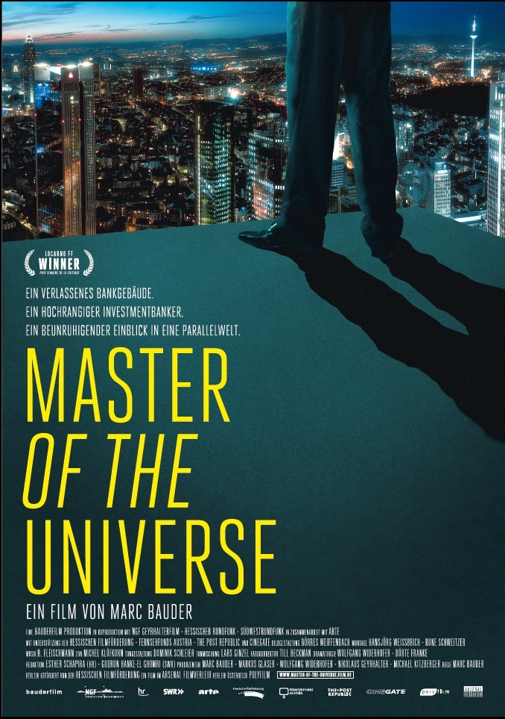
Master of the Universe
Marc Bauder
Deutschland, Österreich 2013, 88 min.
Recommanded for:
Social Studies, Politics, History, Economy, Religion/Ethics, Philosophy, Art
10th grade upwards
15 years upwards

Slide 12

Master of the Universe - Trailer

Slide 13
School Screenings Film Literacy 3-step-programme
Preparation
Visiting the students in the classroom
Screening and Discussion
In the cinema
Wrap-up in class
Learn to work with viewing instructions
Didactic material enables teachers to explore the content and formal dimensions of the films.
App. 60 min. discussion with director
Introduction: the documentary genre and the topic
Every one watches the film with a viewing instruction

Slide 14
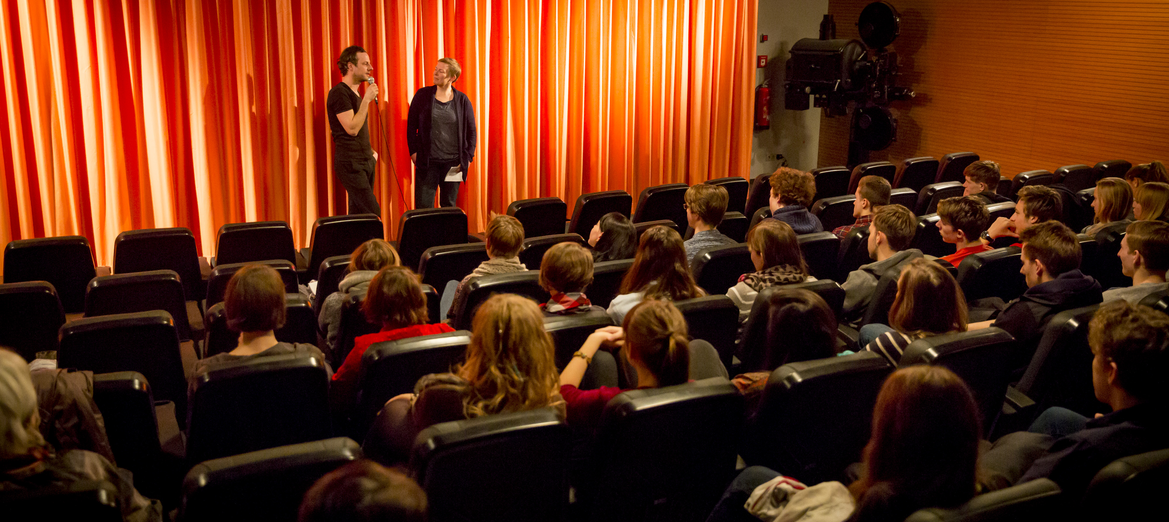
film discussion with Marc Bauder

Slide 15
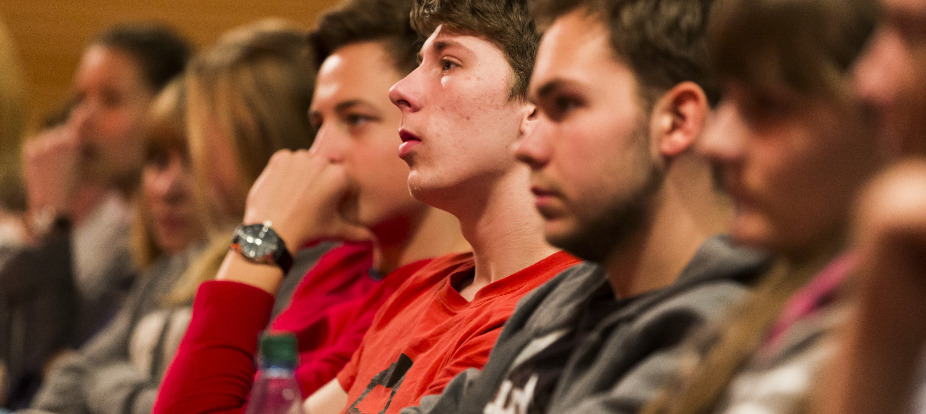
film discussion with Marc Bauder

Slide 16
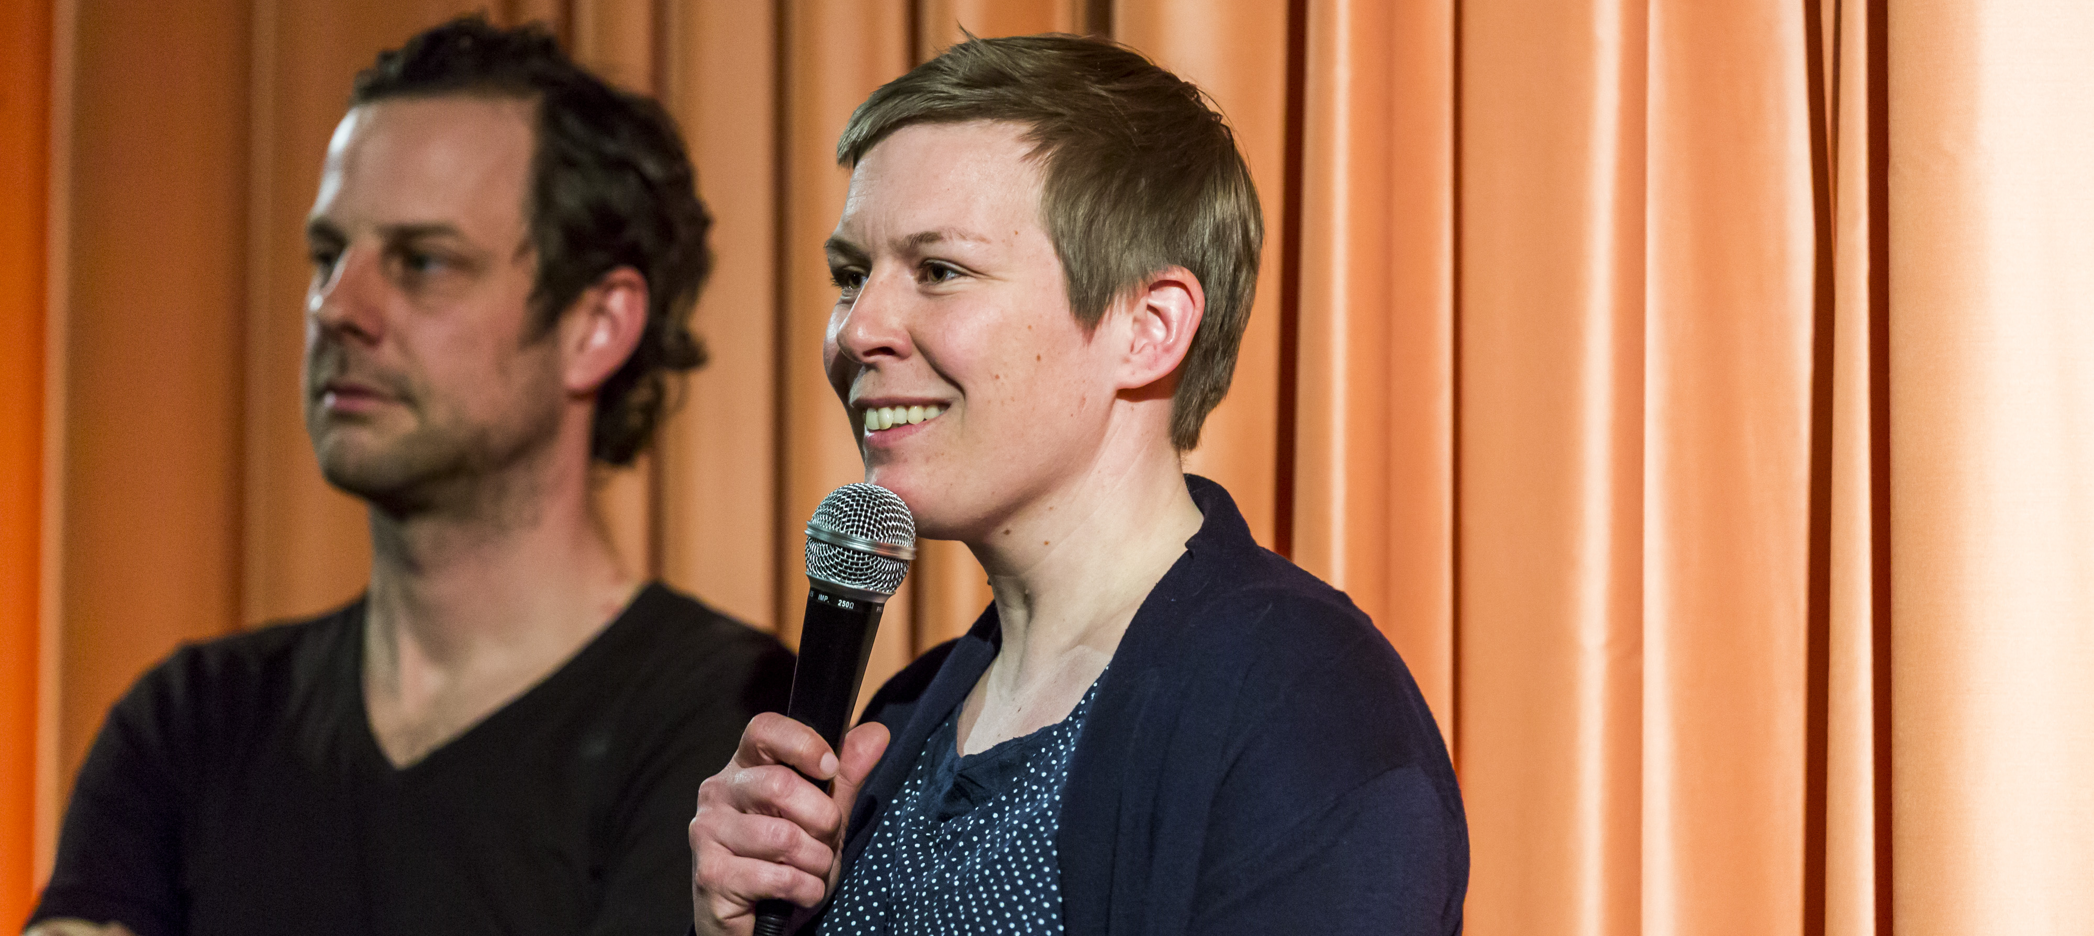
film discussion with Marc Bauder

Slide 17
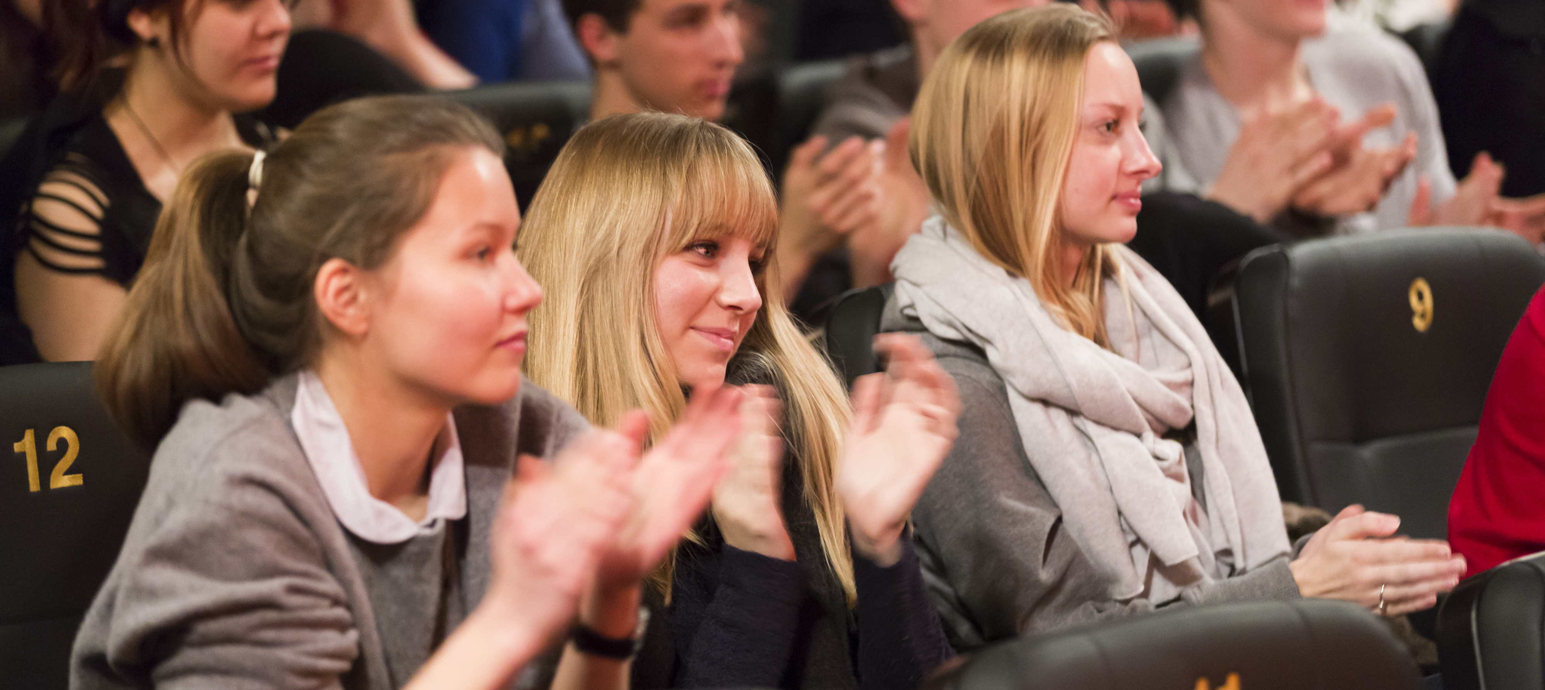
film discussion with Marc Bauder

Slide 18
The didactic material
Specially created didactic material for each film
Enables teachers to explore the content and formal dimensions of the films
App. 25-30 Pages, pdf resource under Creative Commons License
Material is available on our website
Partner: Federal Agency for Civic Education, highly respected resource of information for teachers all over Germany.

Slide 19
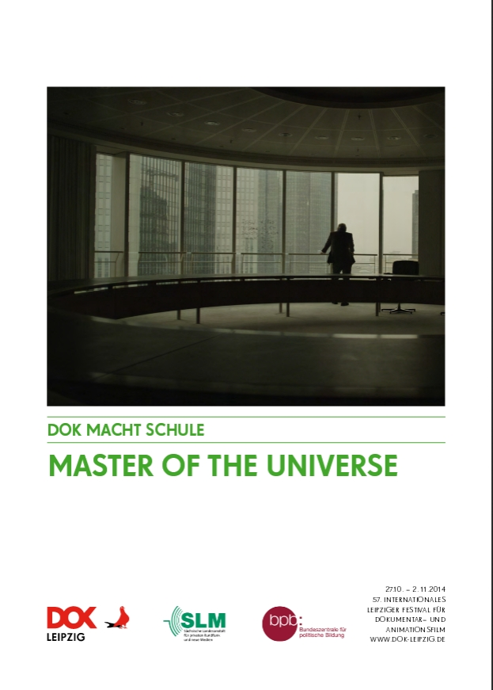

Slide 20
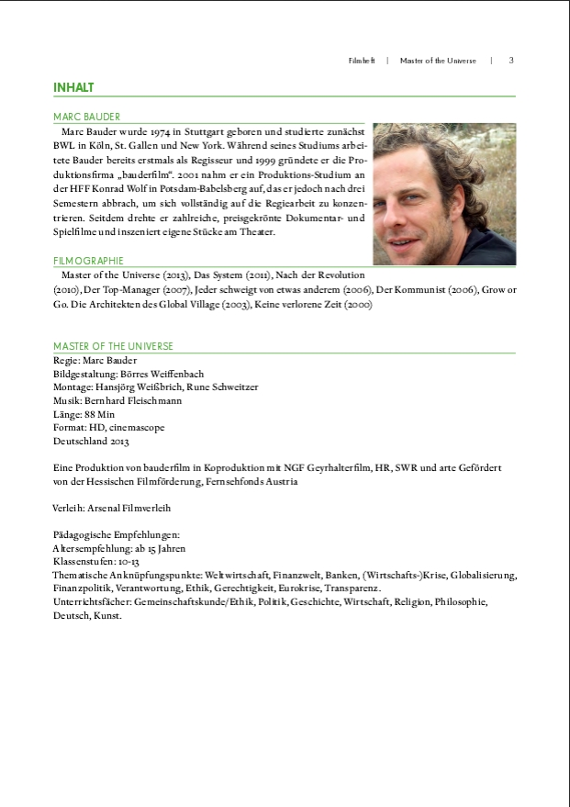

Slide 21
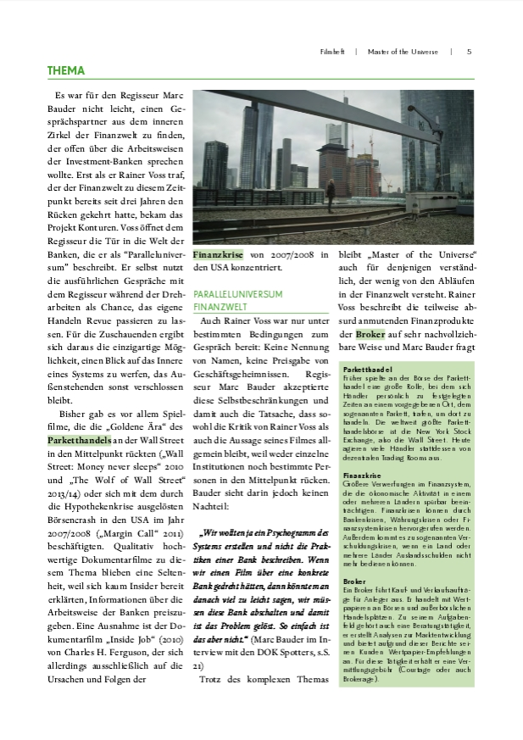

Slide 22
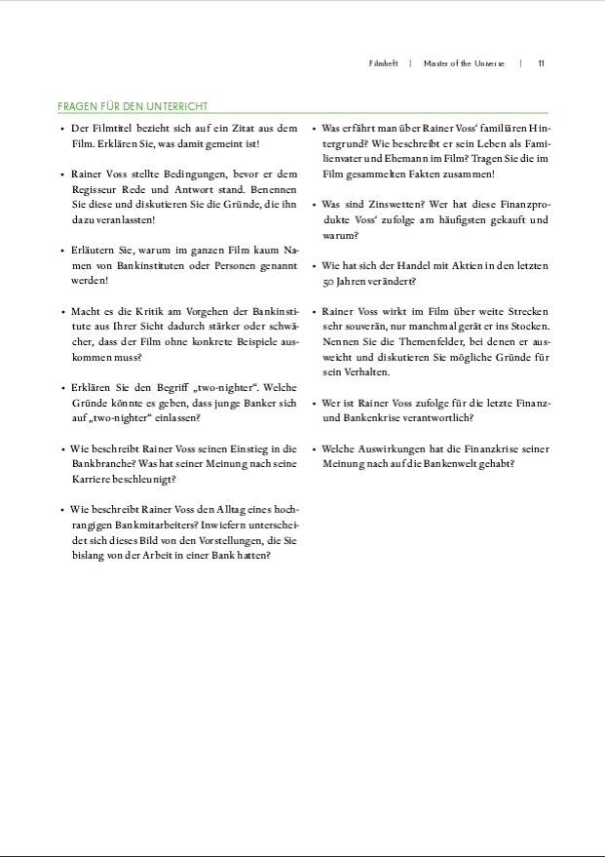

Slide 23
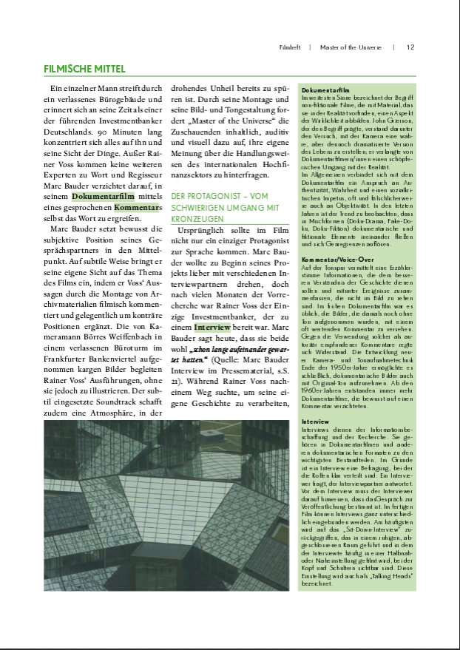

Slide 24
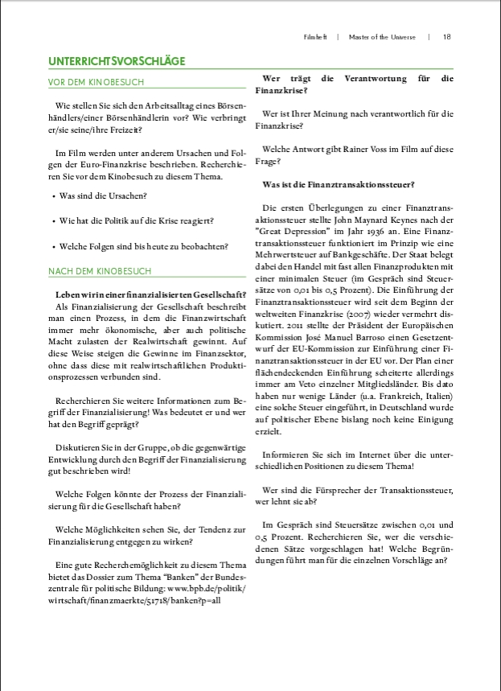

Slide 25
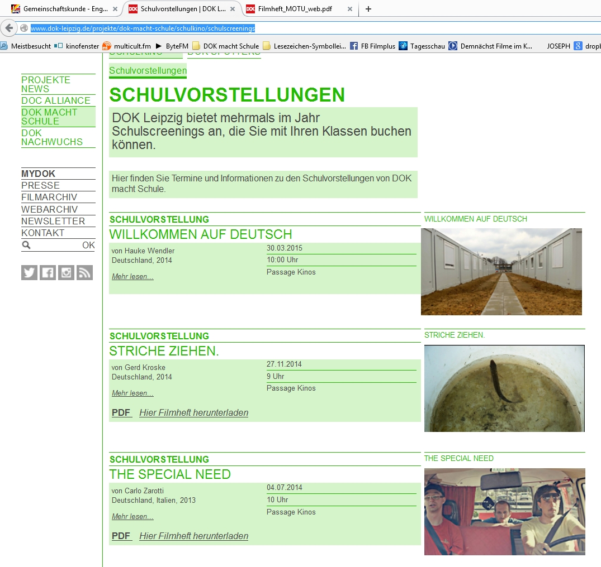
Didactic Materials – open for use Download here

Slide 26
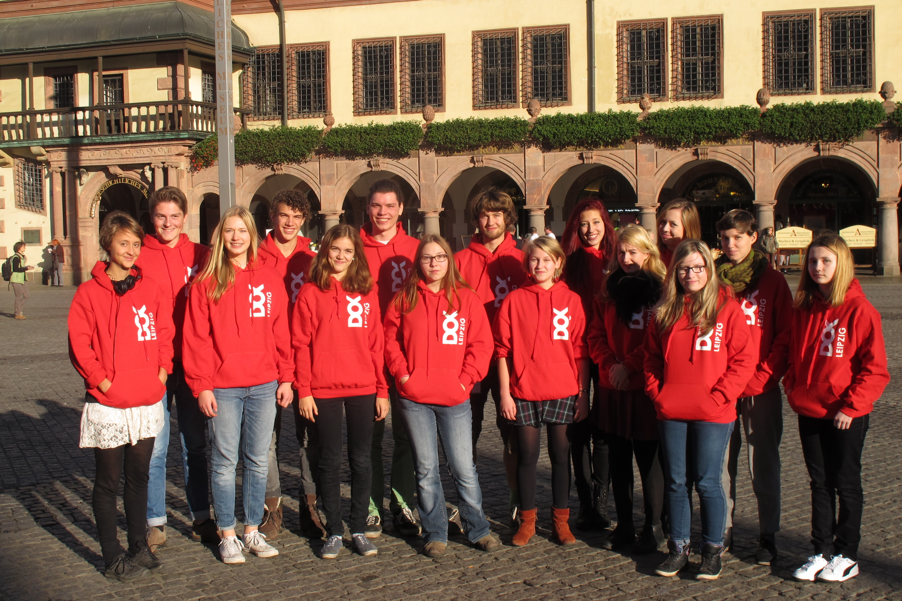
DOK Spotters Practical media competence

Slide 27
DOK Spotters young journalists workshop
The heart of DOK Leipzig’s media literacy activities
15 pupils between 14 and 18 years
1 week full of films, interviews, videos, radio shows, texts and discussions
As members of the editorial team the youngsters get first-hand experience of how journalism works.
Cooperations with the local newspaper, radio station and magazine and some nation-wide youth magazines.
Check out there blog on www.dok-spotters.de

Slide 28
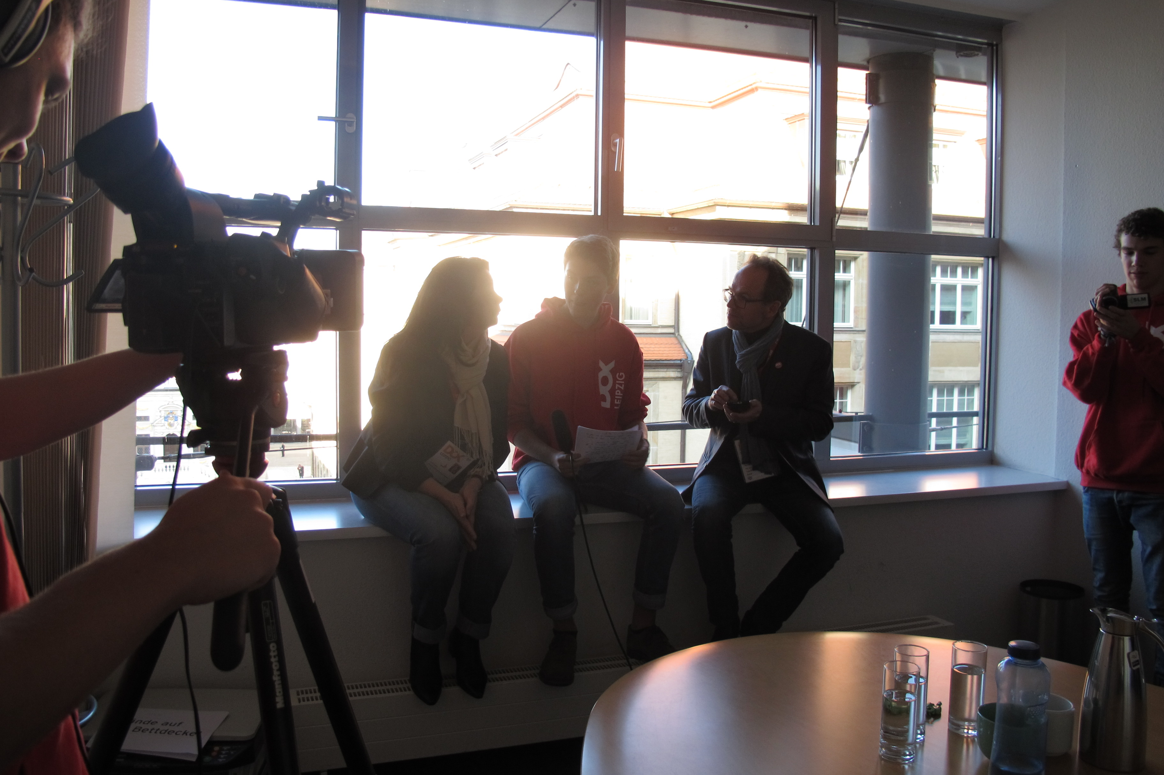
And this is what it looks like when the DOK Spotters are on duty…
http://dok-spotters.de/?p=2917

Slide 29
Conclusions:
Film education is NOT a lesson in film vocabulary (besides you are a film student).
Film education should encourage and enable people to make discoveries.
Film education should trigger the wish to look behind the curtain.

Slide 30
What we as film educators do:
We help to lift the curtain…
… by organizing screenings and discussions
… by providing context knowledge and didactic materials
… by posing questions
… and listening to the answers
The wish to know more and the impulse to have a second look is the beginning of every learning process.
It’s our job as film educators, to trigger this impulse to have a second look.

Slide 31
Thank you for your attention!
Let‘s enter the discussion…

